Slide 1
GLOBAL LAYOFF FROM 2020
Prepared by :
Ahmed Khaled
Nasser Mohamed
Nermin Atif
Osama Adel

Slide 2
About Topic :
Google, Microsoft, Amazon and other companies have laid off more than 300,000 employees in the last three years.
About Dataset :
This dataset was scraped from Layoffs.fyi with the hope to enable Kaggle community to look into analyzing recent mass layoffs and discover useful insights and patterns.

Slide 3
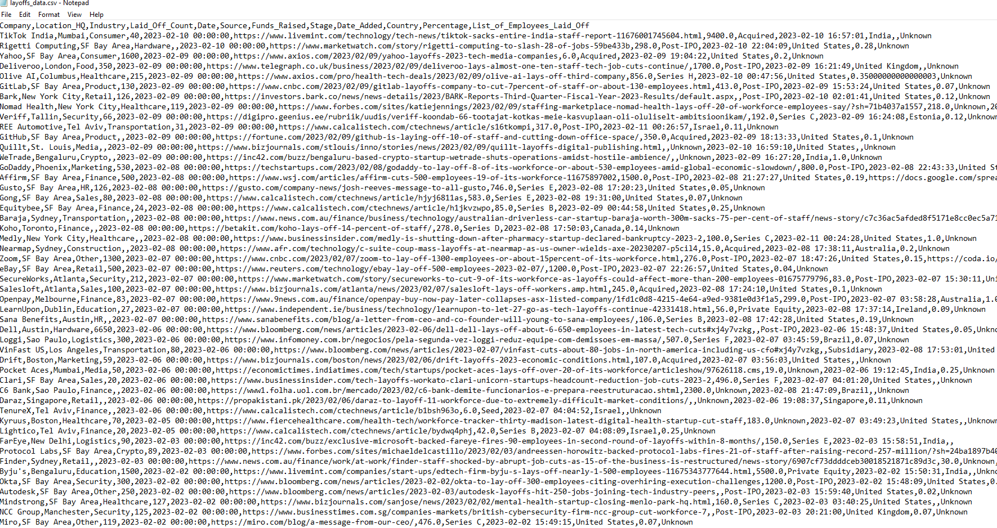
Original dataset using in the Project (CSV file)

Slide 4
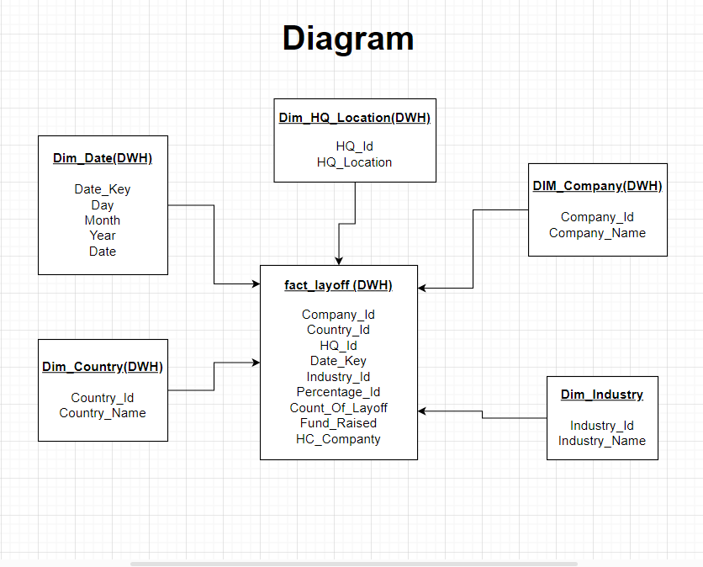
Making (DWH Modeling) using untitled diagram

Slide 5
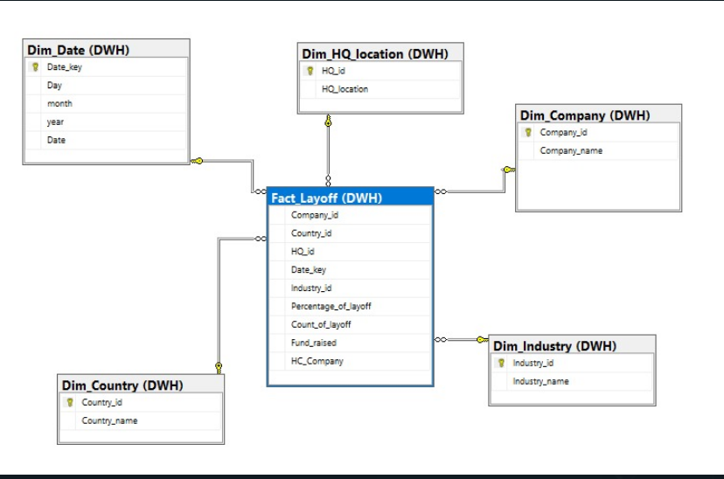
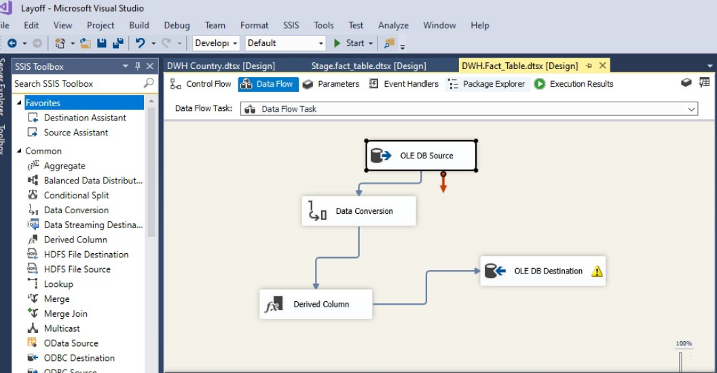
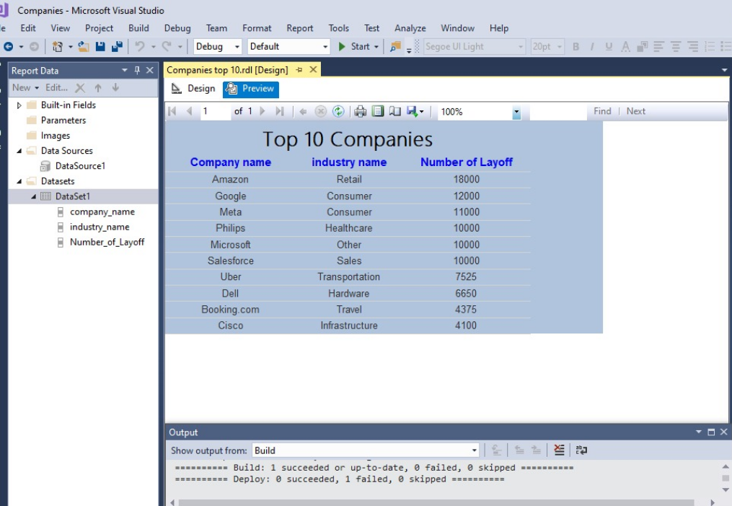
Creating DWH using Sql Services:
Star Schema
SSIS
SSRS

Slide 6
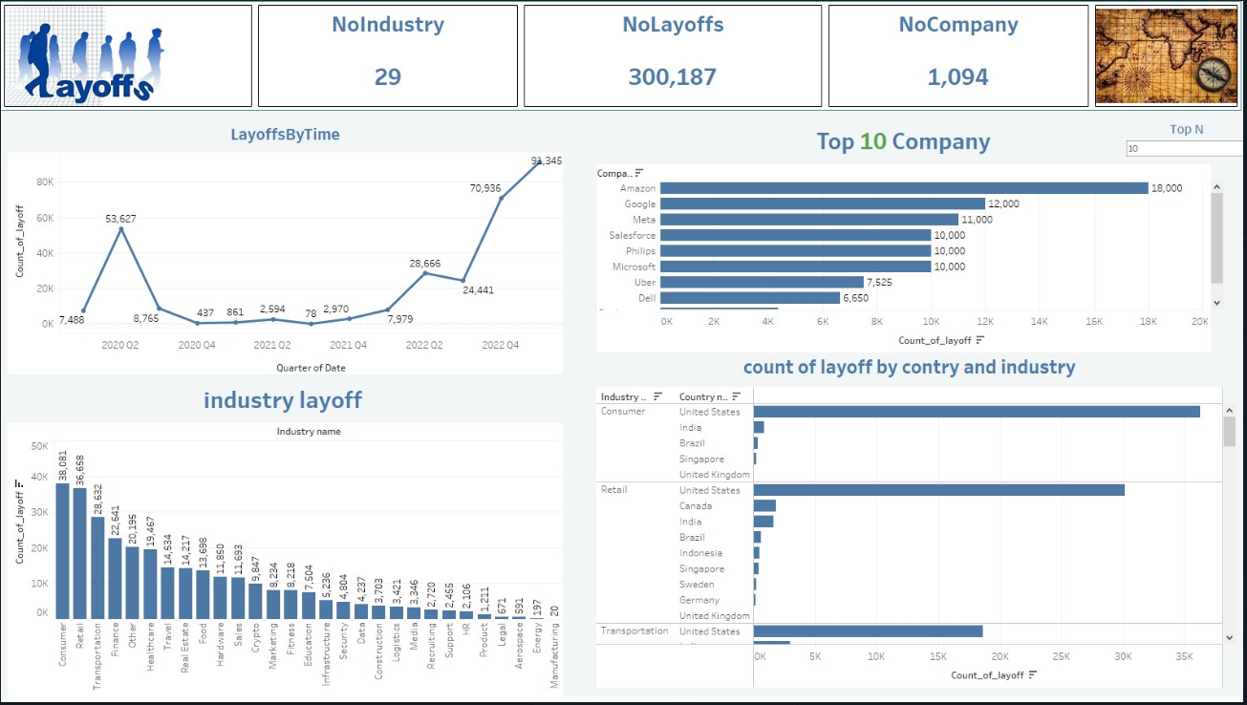
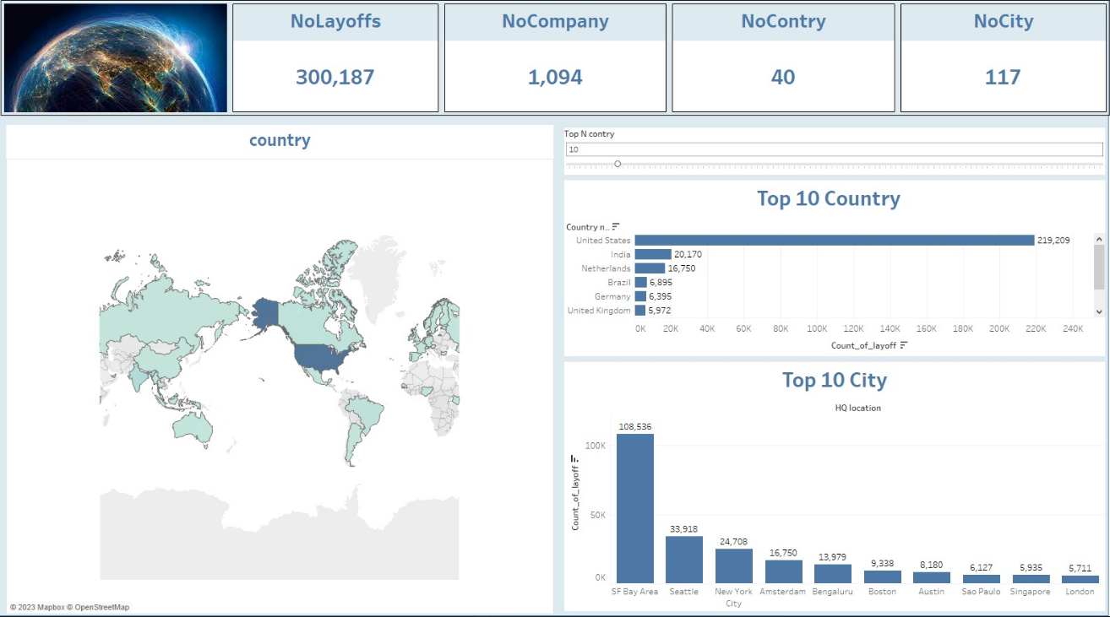
Data Visualization with Tableau:

Slide 7
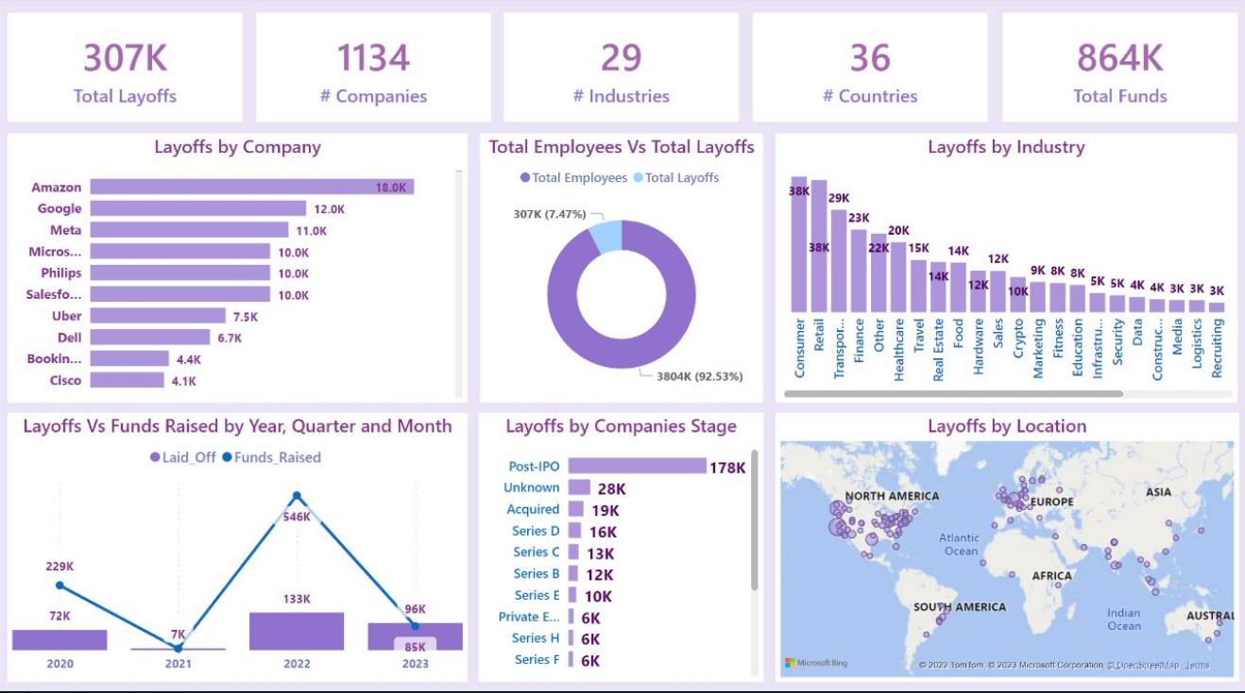
Data Visualization with Power BI:

Slide 8
Thank You

